Slide 1

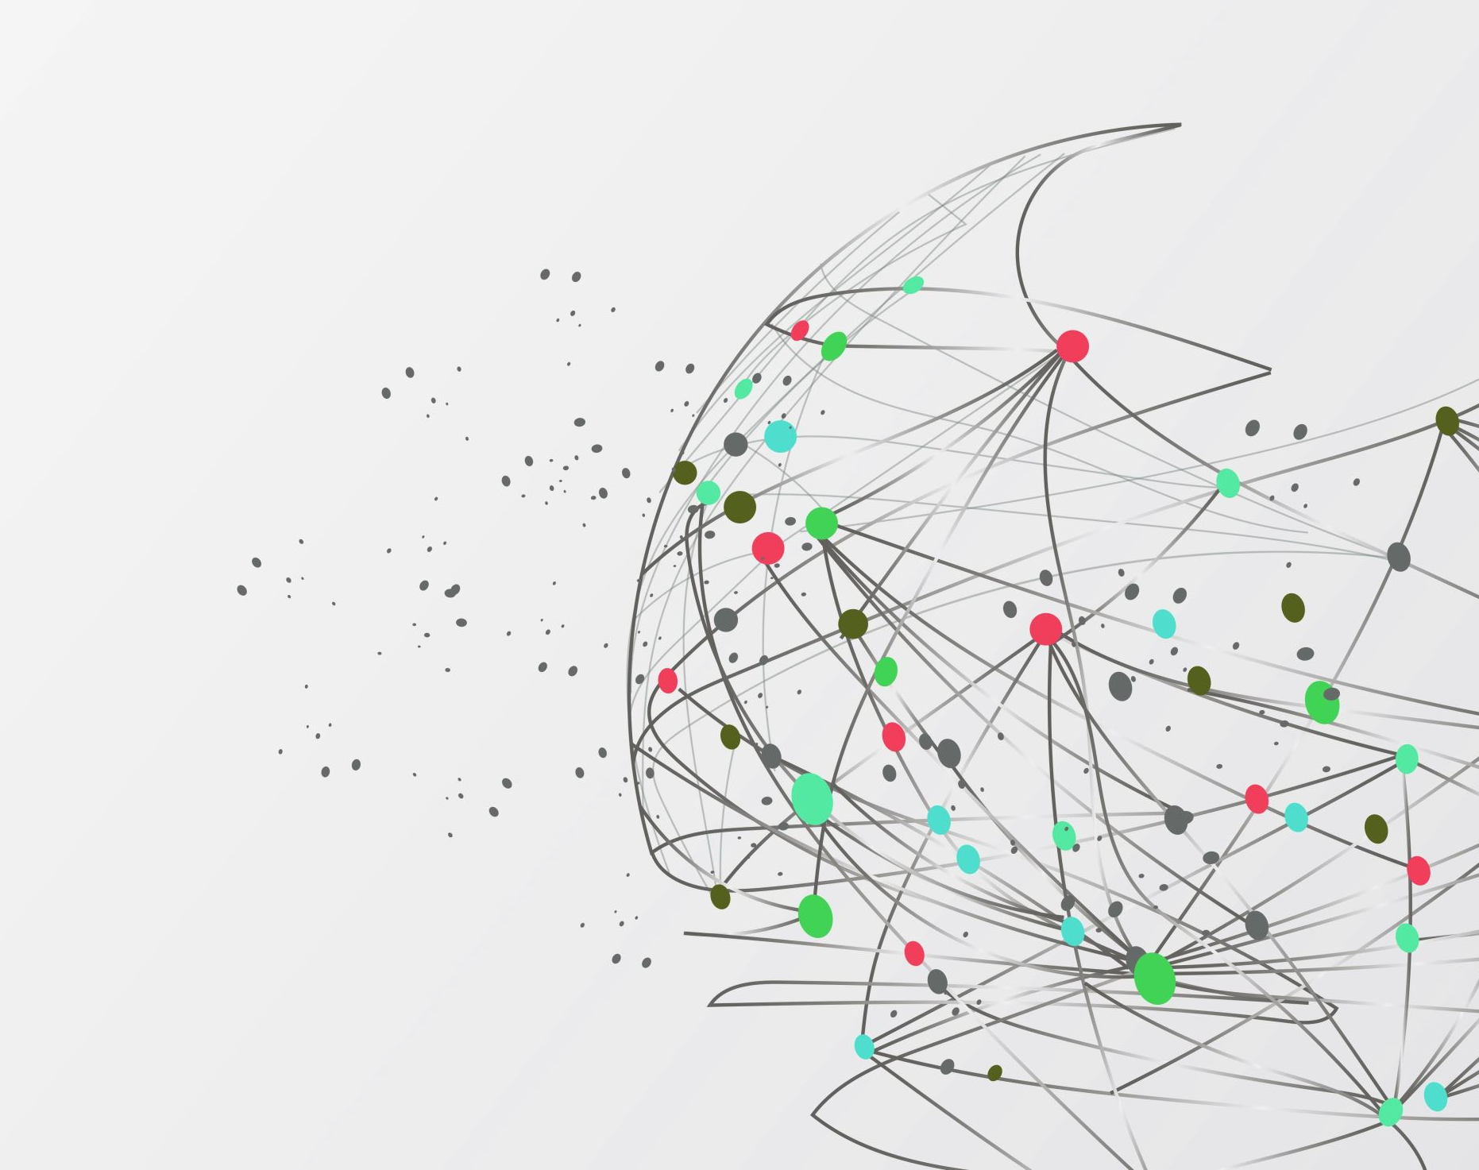

Independent Study in Space Science and Engineering
Topic :
Empirical Physics-Informed Neural Networks for Magnetopause tracking
Student: 侯博瀚 (Po-Han, Hou)
E-mail: kozak20010716@g.ncu.edu.tw
Advisor: 許志浤 教授 (Prof. Jih-Hong, Shue)

Slide 2
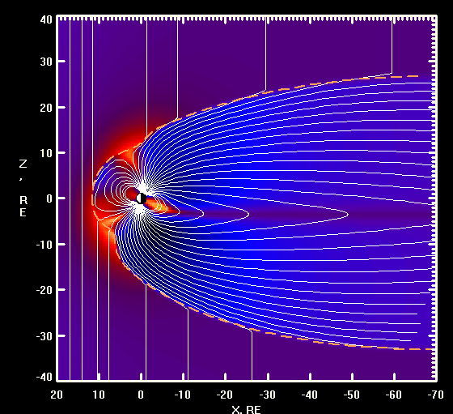


Overview and Background
Terminology Abbreviation:
Interplanetary Magnetic Field → IMF
Dynamic Pressure → Dp
Magnetopause
The boundary where the solar wind dynamic pressure is balanced by the magnetic pressure of Earth's magnetosphere.
Major controlled by IMF Bz & Dp
Acquiring their position
Empirical Method
Machine Learning
Generalization
Based on Physics Theorem
Precision
High precision in fitting process
Generalization
Black Box
Schematic Diagram for Earth Magnetic Field
Roelof and Sibeck [1993]
Shue et al.[1997 / 1998]
Chao et al.[2002]
…
Wang et al. [2008]
Ghisalberti et al. [2022]
Li et al. [2023]
…
Credit: https://geo.phys.spbu.ru/~tsyganenko/modeling.html

Slide 3
Experiment Design and Methodology
Empirical Method
Machine Learning
Generalization
Based on Physics Theorem
High precision in fitting process
Generalization
Black Box
Precision
Physics Based – Machine Learning
(Physics Informed Neural Networks, PINNs)

Slide 4
Data Preprocessing
There are a total of 34,998 magnetopause in-situ crossing data points. (THEMIS(28634), Geo-Tail(5764), ISEE, IMP 8, etc.)
Applying the OMNI dataset recorded every five minutes, identify the corresponding time stamps and calculate the 5-minute averages.

Slide 5
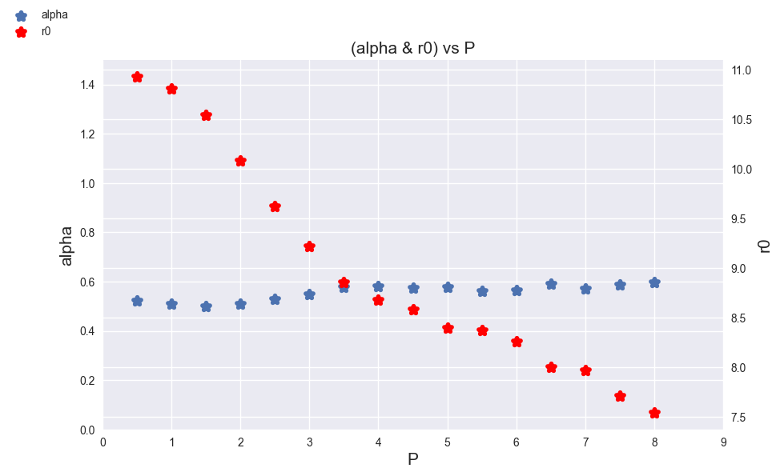
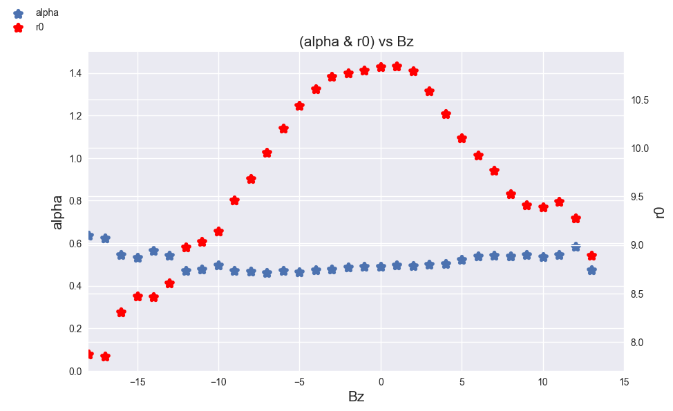
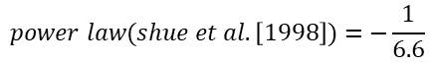
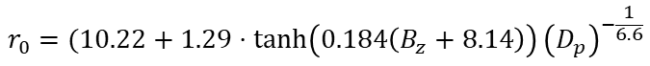
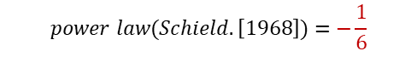
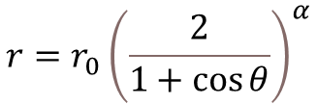
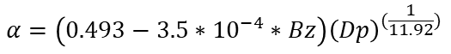
Empirical Methods
$$r=r_{0}{\left(\frac{2}{1+\cos{θ}}\right)}^{α}$$
Major controlled by IMF Bz & Dp
, Shue et al.[1997]
Each bin contains 2 values of Dp, with a shift of 0.5 Dp each time.
Each bin contains Bz values spanning across 3 values, with a shift of 1 Bz each time.
(Li, Sun and Chen, 2023)
$$r_{0}=(10.22+1.29⋅\tanh\left(0.184\left(B_{z}+8.14\right)\right){\left(D_{p}\right)}^{−\frac{1}{6.6}}$$
(Dušík et al. [2010])
Shue et al.[1998]
$$power law(shue et al.\left[1998\right])=−\frac{1}{6.6}$$
$$α=(0.58 −0.007⋅B_{z})(1+0.024⋅ln⁡(D_{p})$$
$$power law(Schield.\left[1968\right])=−\frac{1}{6}$$
Ideal
$$r_{0}=\left(9.332+1.308⋅tanh⁡(0.213\left(Bz+11.191\right)−0.568⋅tanh⁡(0.479(Bz−7.188)\right){\left(Dp\right)}^{(−\frac{1}{6.22})}$$
Proposed Numerical Model
$$α=\left(0.493−3.5∗{10}^{−4}∗Bz\right){\left(Dp\right)}^{(\frac{1}{11.92})}$$

Slide 6
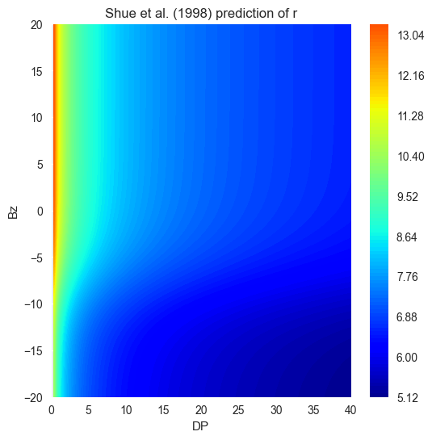
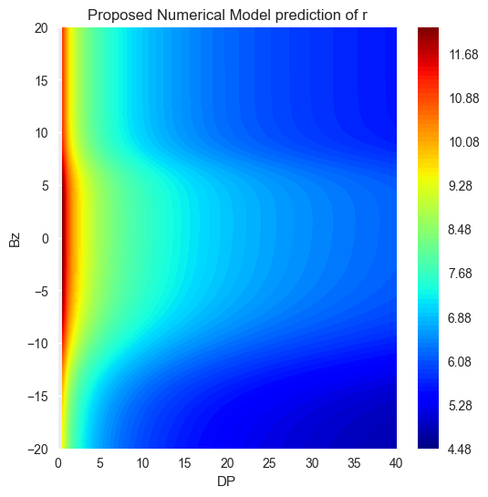
Empirical Methods - Results
Model | RMSE (All) | RMSE(Shue’s dataset)
Shue et al.[1998] | 1.22321 Re | 1.34754 Re
Proposed Empirical Model | 1.19232 Re | 1.33783 Re
MCMC | 1.19587 Re | 1.32348 Re

Slide 7


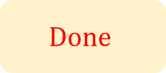



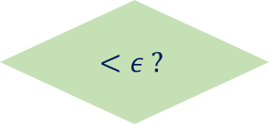

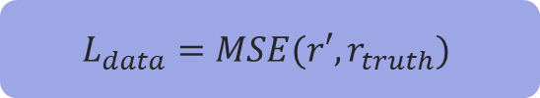
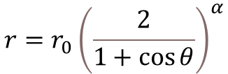



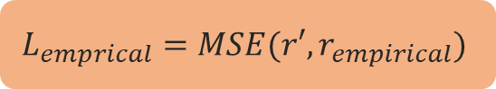

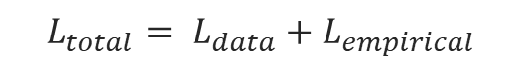

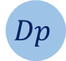

Proposed Algorithm
$$r=r_{0}{\left(\frac{2}{1+\cos{θ}}\right)}^{α}$$
Empirical PINNs
$$L_{emprical}=MSE(r′, r_{empirical})$$
Vanilla DNN
$$σ$$
$$Bz$$
$$σ$$
$$σ$$
$$σ$$
$$r′$$
$$L_{data}=MSE(r′, r_{truth})$$
$$Dp$$
$$σ$$
$$σ$$
$$σ$$
$$θ$$
$$σ$$
$$σ$$
$$<ε ?$$
$${L_{total}= L}_{data}+L_{empirical}$$
Proposed Algorithm: (Emp-PINNs)
Empirical Physics Informed Neural Networks
$$Done$$

Slide 8
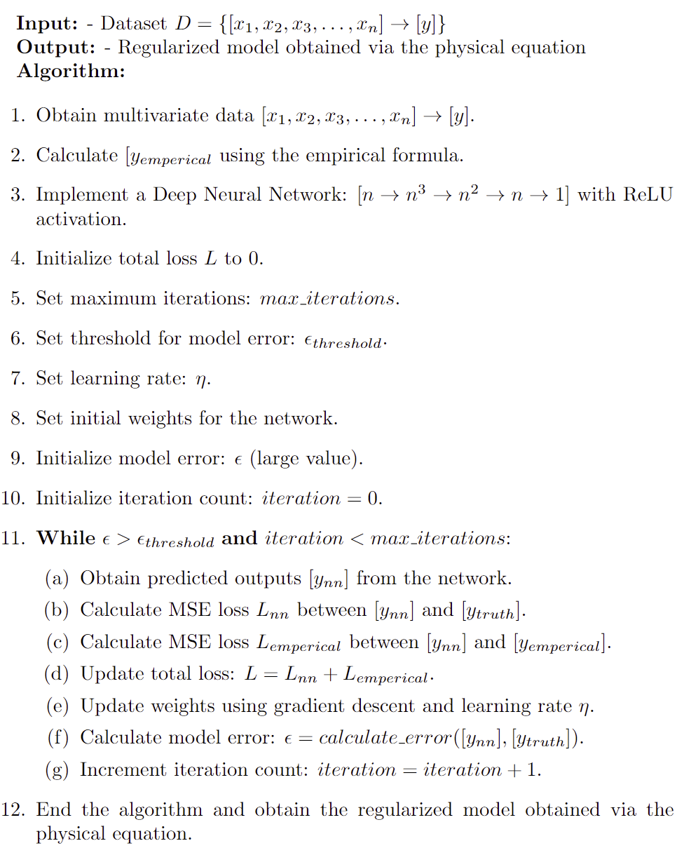
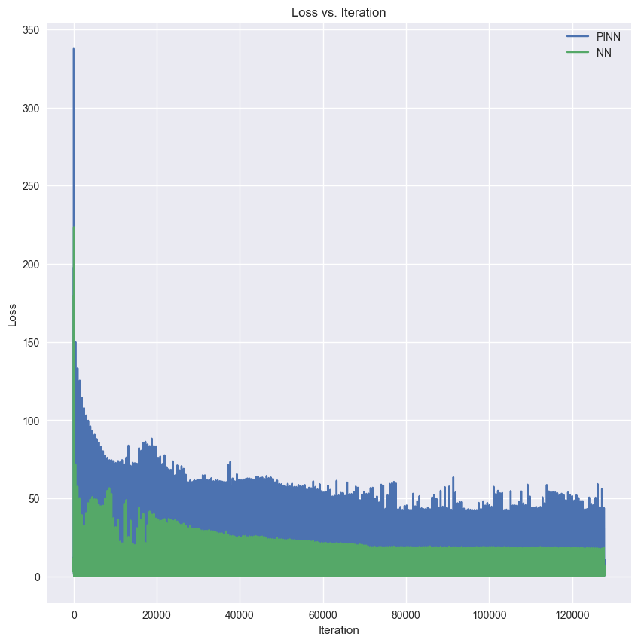
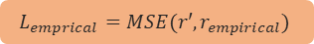




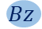

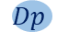
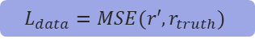
The algorithmic process used for a single output
$$σ$$
$$L_{emprical}=MSE(r′, r_{empirical})$$
$$Bz$$
$$σ$$
$$σ$$
$$σ$$
$$r′$$
$$Dp$$
$$σ$$
$$L_{data}=MSE(r′, r_{truth})$$
$$σ$$
$$σ$$
$$θ$$
$$σ$$
$$σ$$
$$<ε ?$$
$$Done$$

Slide 9
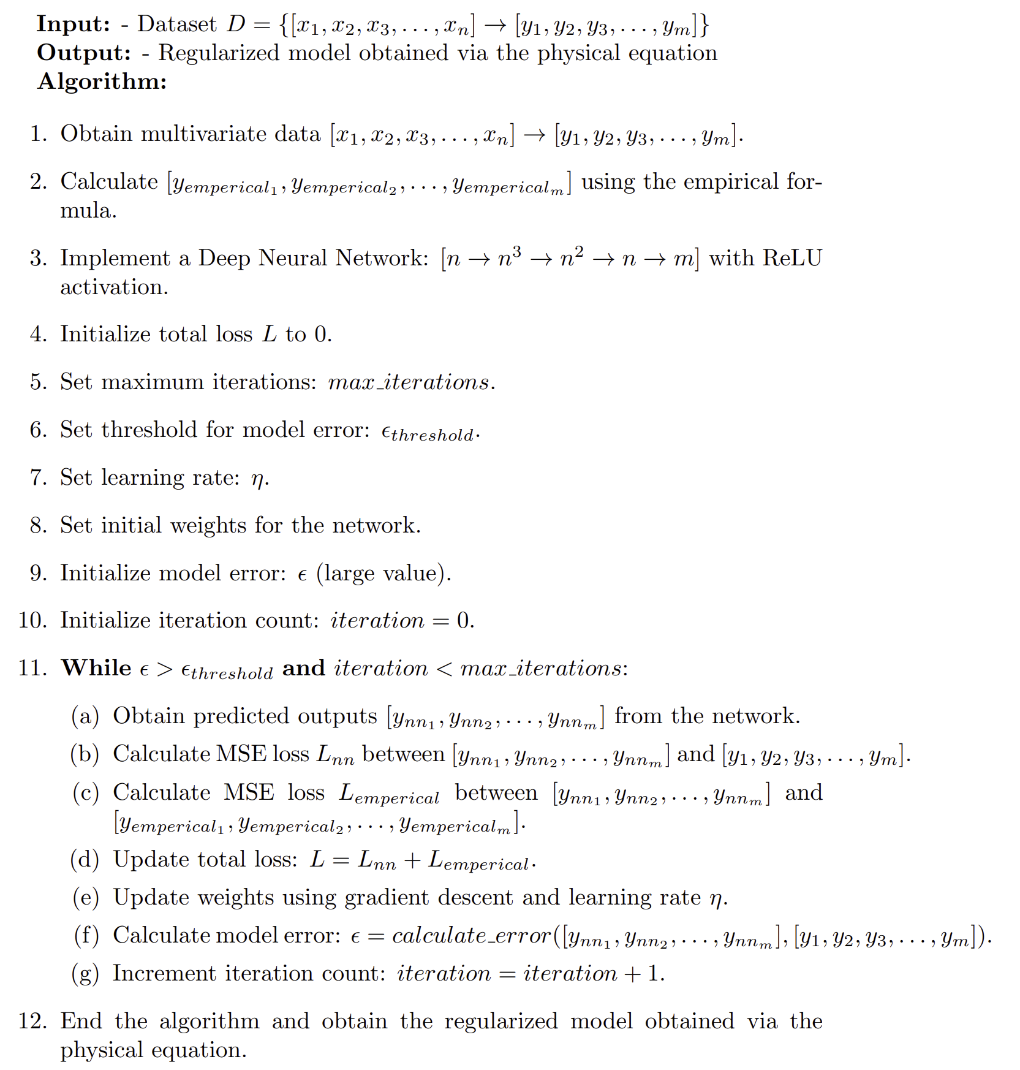
General Form of Algorithm
(Emp-PINNs)
Inspired from PINNs which merely focus on ODEs and PDEs
It can be applied with algebraic equations
Alleviate the over-fitting → Generalization

Slide 10
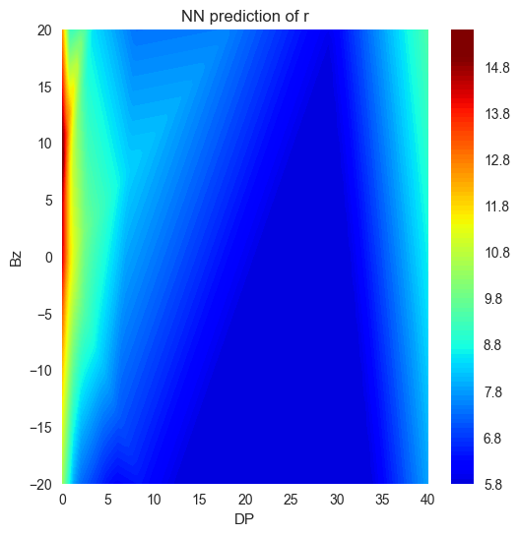
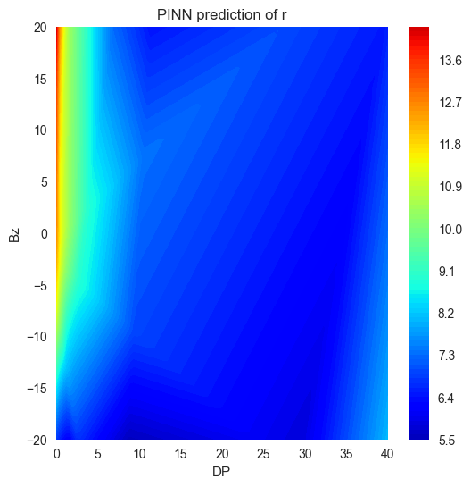
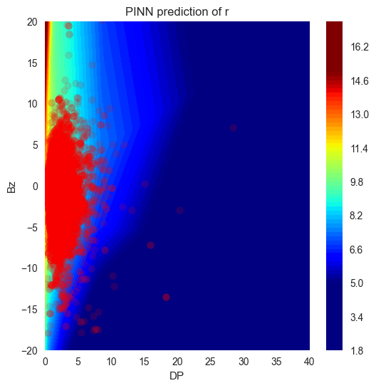
Applying Proposed Numerical Model with NNs
Model | RMSE (Total) | RMSE (20% Testing) | RMSE (80% Testing)
Shue et al.[1998] | 1.22321 Re | 1.02368 Re | 1.26587 Re
Neural Networks | 0.85437 Re | 0.94781 Re | 1.10475 Re
Emp-PINNs - Shue et al.[1998] | 0.90103 Re | 0.92539 Re | 0.95703 Re
Emp-PINNs - Proposed Model | 0.91375 Re | 0.89304 Re | 0.92483 Re
Improved 26.9%
Training set RMSE: ${Loss}_{NN}< Loss_{PINN}< Loss_{Shue}$
Successful in Generalization

Slide 11
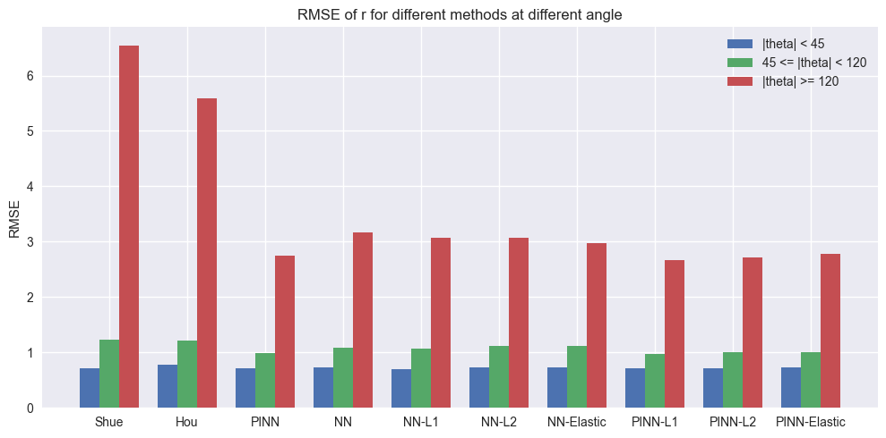
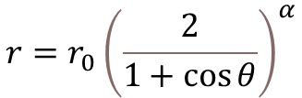
Model Performance at different conditions - Angle
$$r=r_{0}{\left(\frac{2}{1+\cos{θ}}\right)}^{α}$$

Slide 12
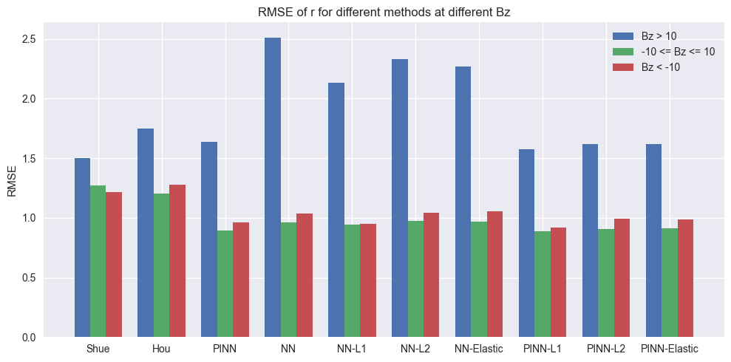
Model Performance at different conditions - Bz
$$r=r_{0}{\left(\frac{2}{1+\cos{θ}}\right)}^{α}$$

Slide 13
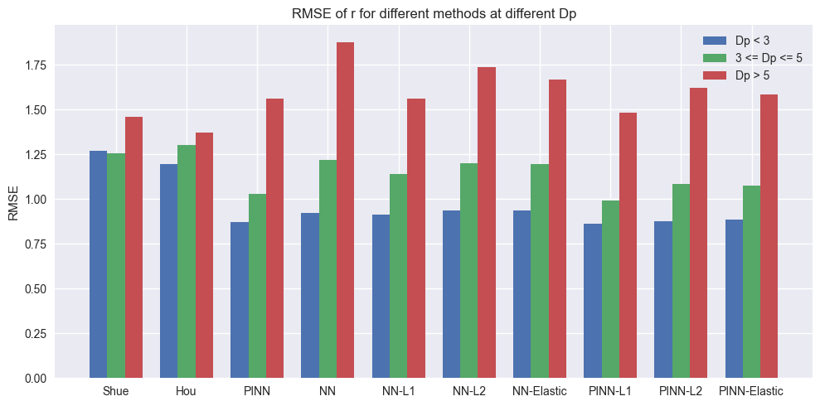
Model Performance at different conditions - Dp
$$r=r_{0}{\left(\frac{2}{1+\cos{θ}}\right)}^{α}$$

Slide 14
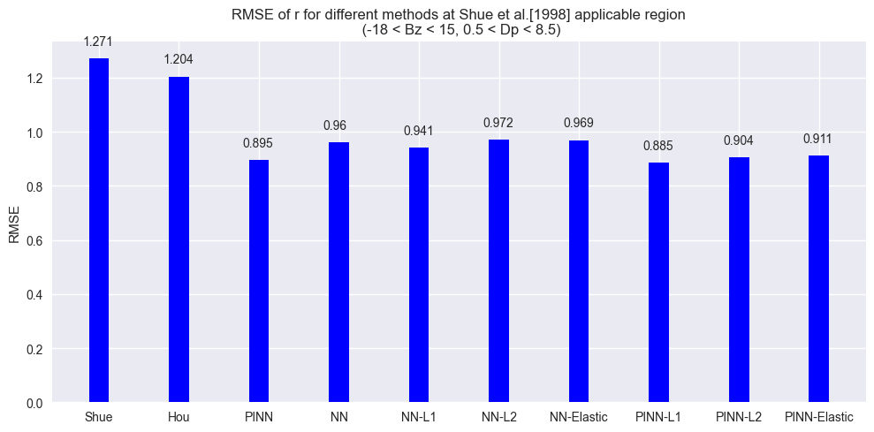
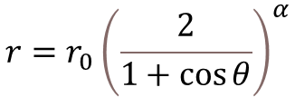
Model Performance at Shue et al.[1998] applicable region
$$r=r_{0}{\left(\frac{2}{1+\cos{θ}}\right)}^{α}$$
Improved 29.6%

Slide 15
Conclusions
The proposed algorithm (Emp-PINNs) combines the advantages of empirical methods and machine learning.
Emp-PINNs is an algorithm that constrains vanilla neural networks to converge on predictions and enhances generalization by excluding intervening outliers.
Emp-PINNs greatly improve the model's performance in predicting the location of the Magnetopause, achieving a remarkably improvement of 29.6%.
L1 (Lasso), L2 (Ridge), and Elastic regularization techniques show a significant improvement in predicting the variable r when Bz varies.
Emp-PINNs significantly improves the precision within the applicable scope of Shue et al. [1998], especially the Emp-PINNs + L1 Regularization.

Slide 16
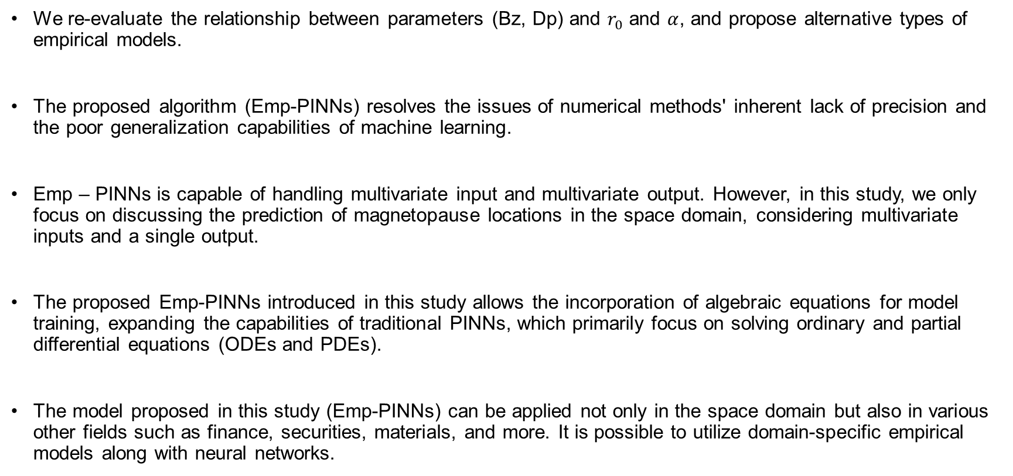
Take-Home Messages
We re-evaluate the relationship between parameters (Bz, Dp) and $r_{0}$ and $α$, and propose alternative types of empirical models.
The proposed algorithm (Emp-PINNs) resolves the issues of numerical methods' inherent lack of precision and the poor generalization capabilities of machine learning.
Emp – PINNs is capable of handling multivariate input and multivariate output. However, in this study, we only focus on discussing the prediction of magnetopause locations in the space domain, considering multivariate inputs and a single output.
The proposed Emp-PINNs introduced in this study allows the incorporation of algebraic equations for model training, expanding the capabilities of traditional PINNs, which primarily focus on solving ordinary and partial differential equations (ODEs and PDEs).
The model proposed in this study (Emp-PINNs) can be applied not only in the space domain but also in various other fields such as finance, securities, materials, and more. It is possible to utilize domain-specific empirical models along with neural networks.

Slide 17
References
Shue, J.-H. et al. (1997) ‘A new functional form to study the solar wind control of the magnetopause size and shape’, Journal of Geophysical Research: Space Physics, 102(A5), pp. 9497–9511. Available at: https://doi.org/10.1029/97JA00196.
J.-H. Shue et al. (1998) ‘Magnetopause location under extreme solar wind conditions’, Journal of Geophysical Research: Space Physics, 103(A8), pp. 17691–17700. Available at: https://doi.org/10.1029/98JA01103.
Dusik, S., et al. (2010). THEMIS observations of magnetosheath‐like plasma in the near‐Earth magnetotail. Journal of Geophysical Research: Space Physics, 115(A12), A12223. https://doi.org/10.1029/2010JA015681
Raissi, M., Perdikaris, P. and Karniadakis, G.E. (2019) ‘Physics-informed neural networks: A deep learning framework for solving forward and inverse problems involving nonlinear partial differential equations’, Journal of Computational Physics, 378, pp. 686–707. Available at: https://doi.org/10.1016/j.jcp.2018.10.045.
Li, S., Sun, Y.-Y. and Chen, C.-H. (2023) ‘An Interpretable Machine Learning Procedure Which Unravels Hidden Interplanetary Drivers of the Low Latitude Dayside Magnetopause’, Space Weather, 21(3), p. e2022SW003391. Available at: https://doi.org/10.1029/2022SW003391
The Stata Blog » Introduction to Bayesian statistics, part 2: MCMC and the Metropolis–Hastings algorithm (2016). Available at: https://blog.stata.com/2016/11/15/introduction-to-bayesian-statistics-part-2-mcmc-and-the-metropolis-hastings-algorithm/ (Accessed: 16 May 2023).

Slide 18
Acknowledgements
I would like to express my heartfelt appreciation to Prof. Jih-Hong Shue, Professor at NCU, Mr. Yu-Wei Chen and Mr. Pai-Shen Wang, Researchers at the Space Environment Laboratory – NCU, for their contribution in reinforcing the understanding of magnetopause. Additionally, I would like to extend my gratitude to Dr. Chun-Yu Lin, Associate Researcher at NCHC – NARLabs, for providing invaluable insights into the concept of Physics Informed Neural Networks and for engaging in fruitful discussions.

Slide 19
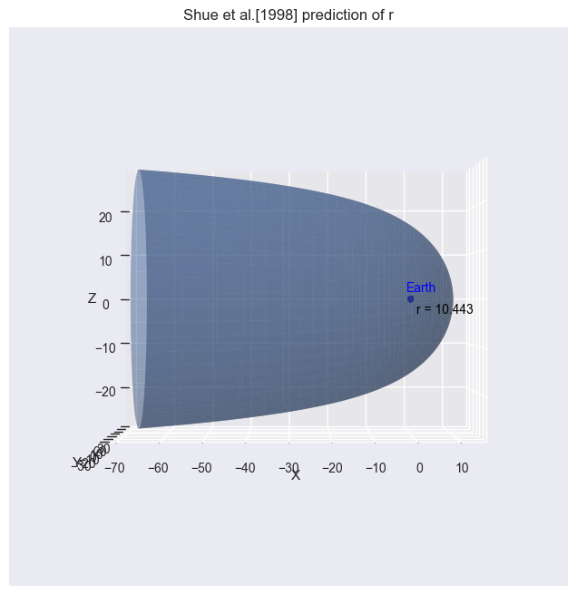
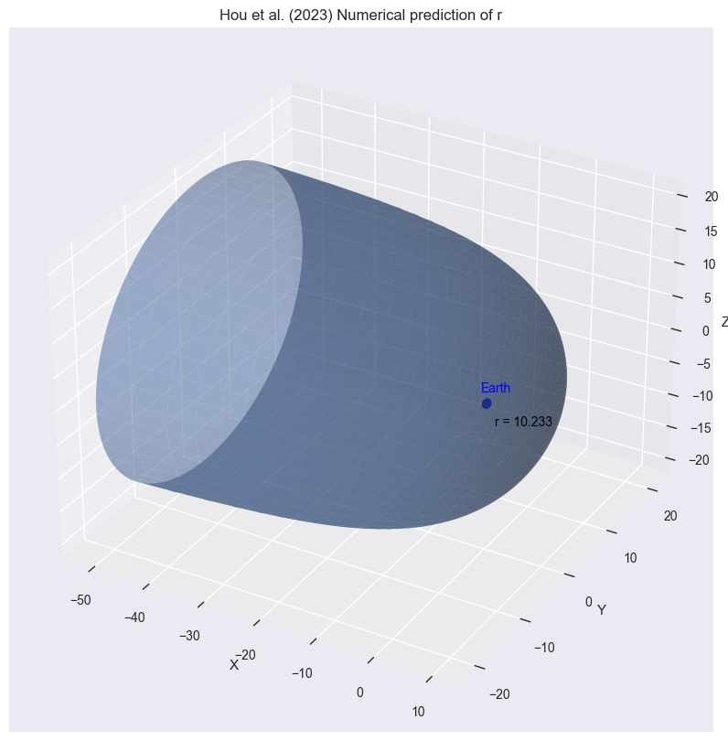
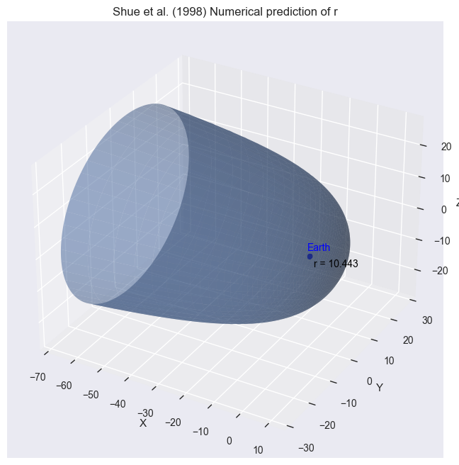
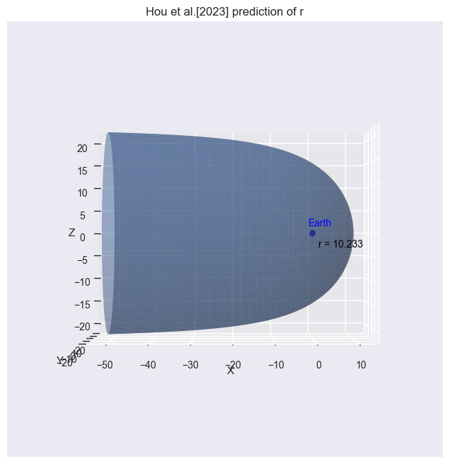

Slide 20
